Slide 2
EEG Signal Processing Brain Computer Interfacing: Steady State Visually Evoked Potentials
Group 31• 27.04.18
Prashanth H C
Pavan Kumar D
Sawan Singh Mahara
Lakshmiraj
Mrs. Vidya T V
Assistant Professor, PESIT-BSC

Slide 3



SSVEP Setup
EEG
f1
f2
f3
f4
f5
f6
f7
f8
f9
Focus on one of the flickering lights
EEG has a periodic signal embedded in it
An array of LEDs
Which light
Classifier

Slide 4
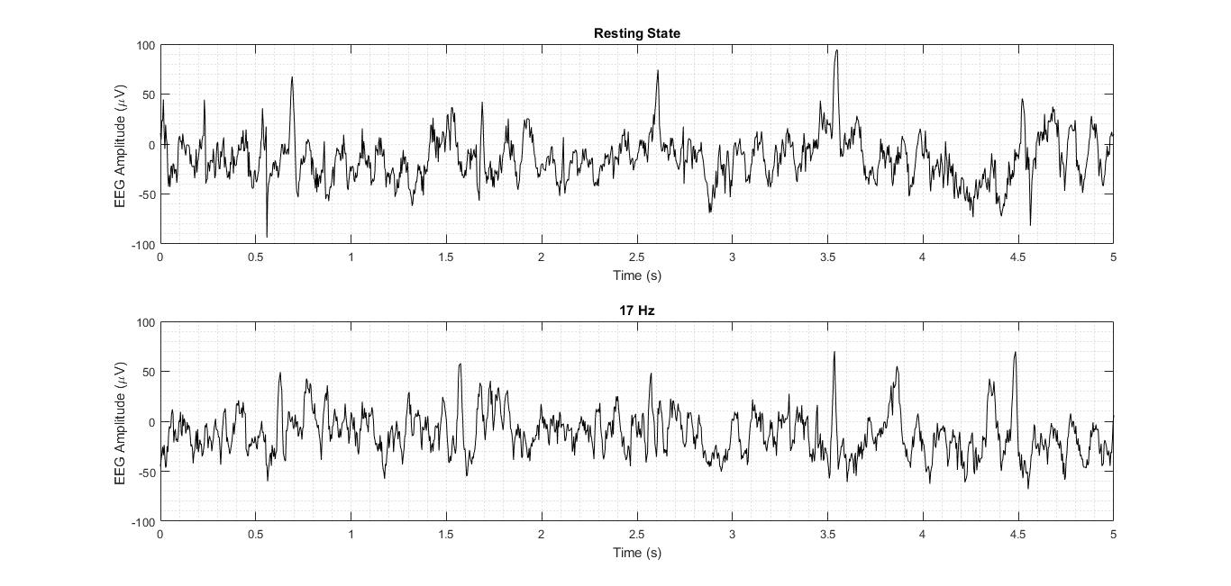
Normal EEG vs EEG in SSVEP (time domain)

Slide 5
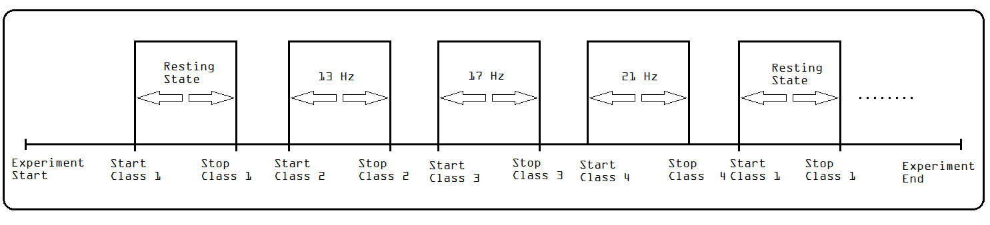
EEG Montage

Slide 6
A

Slide 7
A
B

Slide 8
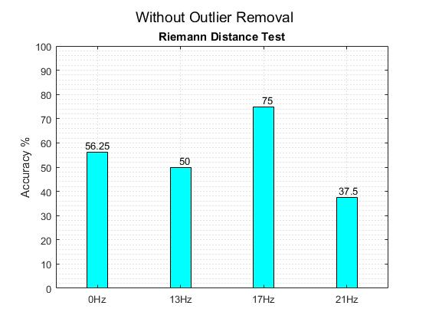
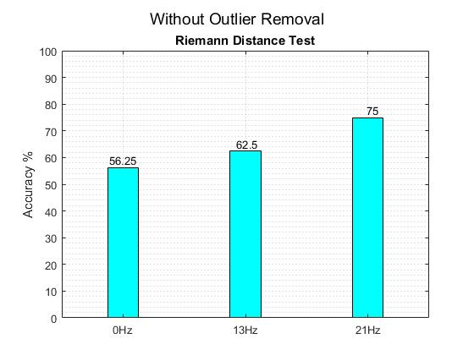
Bar Chart Results

Slide 9
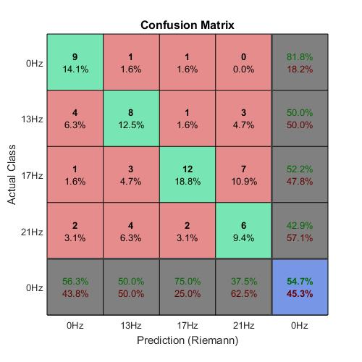
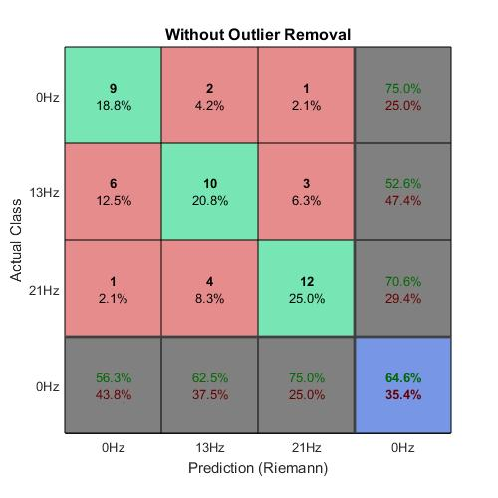
Confusion Matrix Results

Slide 10
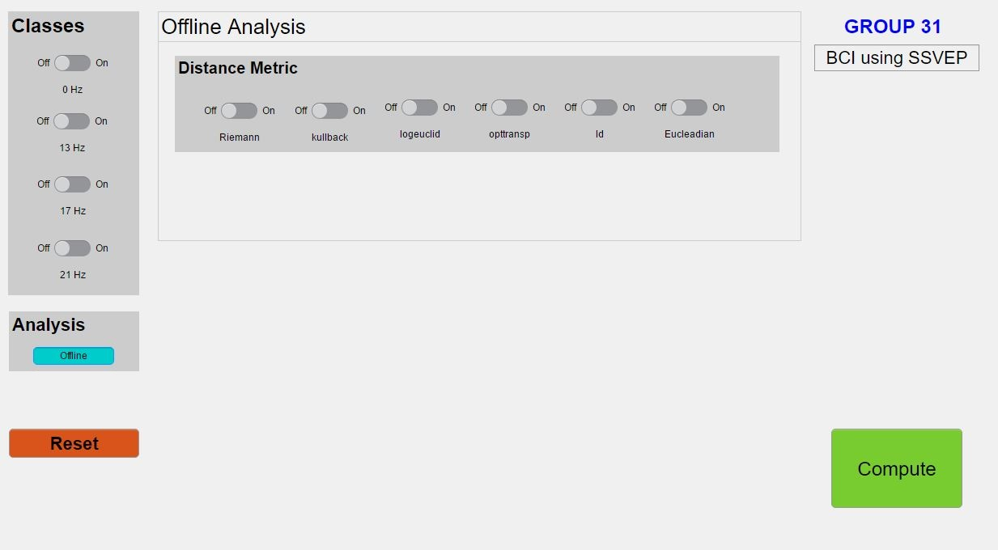
GUI

Slide 11
Thank You

